Slide 1
Structs
Creative Commons Attribution-NonCommercial-ShareAlike 3.0 Unported License. http://creativecommons.org/licenses/by-nc-sa/3.0/
Written by Rachel J. Morris, last updated 2015-02-05

Slide 2

Beginning the Object Oriented Programming Adventure...

Slide 3
Structures
So far in our programs, we've been utilizing variables and functions.
Now that we're getting into Object Oriented Programming, we're going to begin making our own data types.
To do this, we define structs or classes (more on classes later).
“while not done”
Both of these can contain their own variables and functions internally.

Slide 4
Structures
Object Oriented Programming is one of the strengths of C++ (and similar languages),
It helps us create models of data, grouping like things together.
By grouping information together, it also becomes easier to read, more manageable to maintain, and more capable of extending for future features.
“while not done”

Slide 5
Example Structures
Some example objects:
Game Character
Text File
Student
Button
Account
Image
Instant Message
Shopping Cart

Slide 6
Example Structures
Some example objects and their
variables and functionality:
Game Character
Variables
X and Y coordinates
Bitmap image
Experience Points
Maximum Speed
Functions
Move(direction)
TakeDamage(amount)
Animate()
Text File
Variables
Filename
Last update date
Text contents
Functions
ReadLine()
AddLine(text)
Save(filename)
Load(filename)

Slide 7
Example Structures
Some example objects and their
variables and functionality:
Shopping Cart
Variables
List of Purchasable Items
User Account ID
Seconds until timeout
Functions
CalculateTotal()
SendOrder()
Purchasable Item
Variables
Name
Manufacturer
Price
Functions
SubmitReview(info)
GetLatestReviews()
AddToCart()

Slide 8
Structures
With structures, we will group together small amounts of information, like...
CoordinatePair
X, Y
Rectangle
X, Y,
Width, Height
Fraction
Numerator,
Denominator,
Add(...)
Multiply(...)
“while not done”

Slide 9




Structures
Classes will end up being better for larger, more sophisticated objects.
Both classes and structures can store variables and functions.

Slide 10
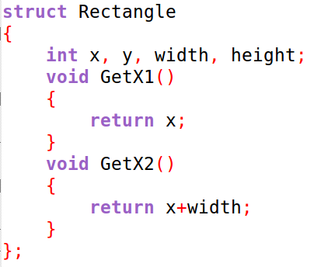
Defining a Struct
We will create our struct objects outside of any functions (including main).
It begins with the keyword struct, followed by the object's name.
The members of the struct are declared/defined within curly braces.
The end of the struct definition must have a semi-colon after the closing brace.

Slide 11
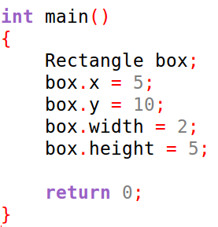
Defining a Struct
After a struct has been created, we can create a data type of that object in our program.
Here, we declare a variable of type Rectangle, and name it box.

Slide 12
Defining a Struct
After a struct has been created, we can create a data type of that object in our program.
To access internal members (variables, functions) of our custom object, we need to use the dot-operator .

Slide 13
Passing by Reference
Because a custom object can contain many variables, arrays, or generally take up a lot of memory...
…you should make sure to get into the habit of passing any objects by const reference into other functions.
Unless you actually need to change that object, then just pass it as a reference.

Slide 14
Sample Programs...
Let's write some code to demonstrate how to use structs.
A. Coordinate Pairs
B. Rectangles
C. Students and Classes

Slide 15
Sample Programs...
Let's write some code to demonstrate how to use structs.
A. Coordinate Pairs
B. Rectangles
C. Students and Classes

Slide 16
Sample Programs...
Let's write some code to demonstrate how to use structs.
A. Coordinate Pairs
B. Rectangles
C. Students and Classes

Slide 17
Sample Programs...
Let's write some code to demonstrate how to use structs.
A. Coordinate Pairs
B. Rectangles
C. Students and Classes

